Slide 1
Desktop Pokédex
Shane White, June 11th, 2024

Slide 2
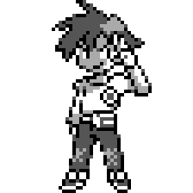
Memorandum
My idea was to create a Pokémon-centered program. The two maintainable tables I had planned to use were Pokémon and Trainer. Tables for Type, Nature, and Region will be populated as they will be used in a dropdown for the Trainer and Pokémon maintenance forms.

Slide 3
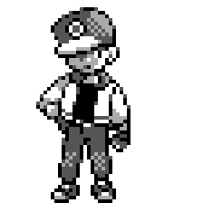
Business Rules
My two business rules were:
- A trainer could have only up to 6 Pokémon
- A trainer could not have more than one of a specific Pokémon

